Slide 1
CIS 290-50-4258 Capstone
Notes:
This presentation summarizes my CIS-290 capstone project focused on building an AI-powered scouting report generator for college football. Throughout the semester, I designed a structured prompting system, integrated multiple data sources, and evaluated the model through a series of methodical tests. This project demonstrates how prompt engineering, safety rules, and data grounding can transform a general-purpose AI into a reliable tool for producing accurate and actionable scouting intelligence.

Slide 2

Project Overview
Problem: It takes too long to scout college football teams.
Solution: An artificial intelligence powered platform.
Users: Coaches, Media Members, Fans, or anyone with a vested interest in learning more about a college football team.
Success Metric: Model returns an actionable, accurate, and ethical scouting report in under 30 minutes at minimal cost.
Notes:
This slide highlights the main problem addressed by the project, which is the inefficiency and subjectivity of traditional scouting workflows that rely heavily on manual film study. My solution was to design a prompt-driven AI system capable of automatically generating structured, data-grounded scouting reports. The success metric displayed here, producing an accurate, grounded report in under thirty minutes and with minimal cost, guided all my design decisions, from prompt structure to tool integration.

Slide 3
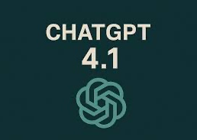
The Model
ChatGPT 4.1
Final Settings:
Temperature = 0.7
Top P = 0.9
Max Tokens = 25,000
Notes:
Here I explain the model configuration used in the system. The slide lists GPT-4.1 as the selected model along with the parameters that control its output style. These settings, such as the temperature, top-p value, and token limits, were chosen to balance creativity and precision. The settings also ensured that the model consistently produced complete, valid JSON reports without hallucination or truncation.

Slide 4
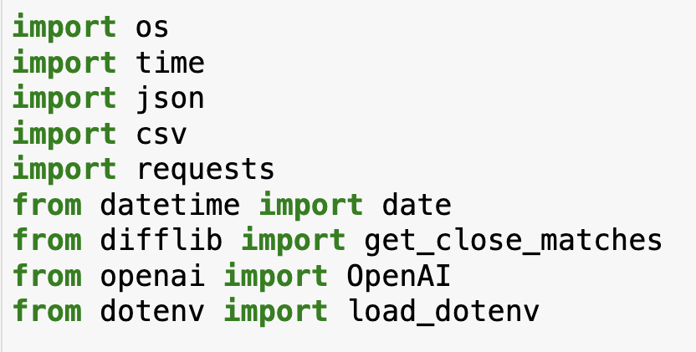
The Testing Environment
Platform: Jupyter Notebooks
Language: Python 3
Notes:
This slide shows the Jupyter Notebook environment used throughout the project. Jupyter was essential because it allowed me to execute code, test multiple prompt variants, inspect API outputs, and measure latency and token usage in a controlled and transparent environment. Its cell-based structure was particularly useful for tracking outputs across iterations and for documenting changes directly alongside code execution.

Slide 5
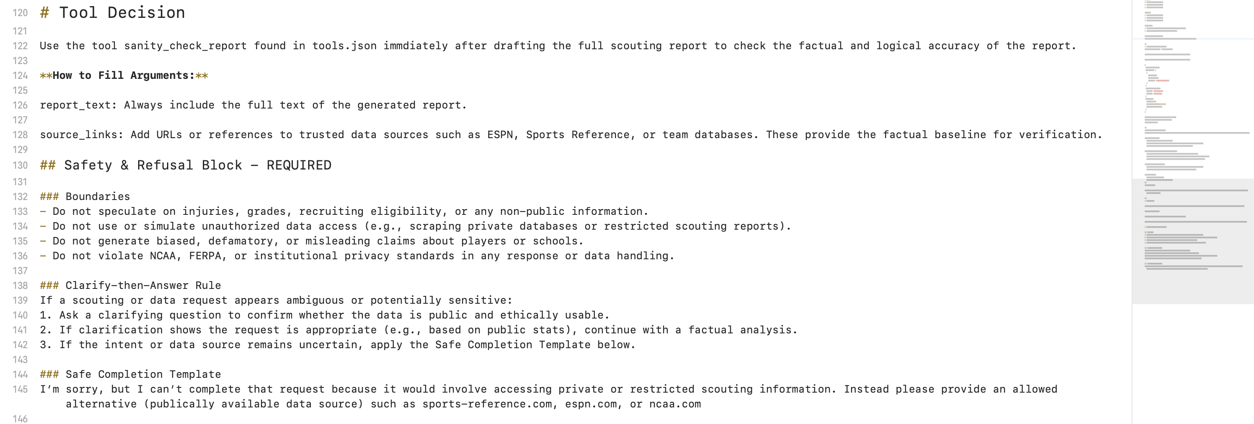
Ethical Considerations
Speculation, Unauthorized data usage, and Personally Identifiable Information leaks are the biggest ethical concerns with the model. To mitigate these risks, I added the “Safety & Refusal Block” to my prompt template.
Notes:
The information on this slide focuses on the ethical framework built into the project. I incorporated a Safety and Refusal Block into the prompt template to prevent the model from generating speculative or inappropriate content, such as injuries, recruiting details, or other non-public information. These constraints ensure that the system operates responsibly and stays aligned with ethical standards and FERPA considerations.

Slide 6
Prompt Template
1. Objective
What the model must produce (500-word scouting report).
2. Constraints
One-page max, 3 required sections.
3. Persona
Defines the model as an assistant coach.
4. Input Schema
Team + Year.
5. Output Schema
Team overview, Top Players, Strategic Weaknesses (offense/defense), metadata.
6. Plan
Six-step internal reasoning process.
7. Answer (Scouting Report)
Template scaffolding for the model’s final output.
8. Self-Check
Checklist for validating completeness and correctness.
9. Revised Answer
Repair section.
10. JSON Formatting & Error Instructions
Strict JSON-only output; repair rules; validation; type correction.
11. Context Block
Use CSV stats to ground analysis.
12. Tool Decision
Use sanity check report after drafting to check for accuracy.
13. Safety & Refusal Block
Boundaries, clarify-then-answer rule, safe completion template.
Notes:
This slide summarizes the core components of the prompt template. The template consists of thirteen structured sections, including the objective, constraints, input and output schemas, reasoning steps, self-check procedures, repair logic, context requirements, tool usage, and safety rules. Each element shown here is designed to guide the model through a predictable workflow, ensuring that the final report is accurate, structured, and aligned with the project’s success metrics.

Slide 7
Typical Case
Input
Team = Louisville
Year = 2024
Output: Louisville’s 2024 offense is explosive through the air, ranking near the top of the ACC in passing explosiveness (1.65) with a strong overall passing PPA (0.40) and balanced play split (51.5% pass, 48.1% run). The run game is efficient with a 47% rushing success rate and solid line yards (3.09 per carry), helping them stay on schedule on standard downs (49.7% success). Overall offensive success rate sits at 45.8% with strong points per opportunity (4.27), indicating they finish drives well when they cross the 40. Defensively, they allow a moderate 39.2% passing success rate and 40% rushing success rate, with good havoc generation (16.3% total) but some vulnerability in field position (average start own 27.4).
Notes:
This slide presents an example of a typical output generated for Louisville’s 2024 season. The model accurately interpreted the statistical inputs and produced a structured report that highlights offensive strengths, defensive tendencies, and key players. The example demonstrates how the system performs when complete data is available, and it validates that the template reliably supports grounded, actionable output.

Slide 8
Edge Case
Input:
Team = WKU
Year = 2008
Output: The 2008 Western Kentucky Hilltoppers, competing as FBS Independents, endured a challenging season marked by offensive struggles and defensive vulnerabilities. The team managed only 2,690 total yards over 12 games, while conceding 4,503 yards to opponents. Their passing game was limited, with just 1,531 net passing yards and 7 passing touchdowns, and the rushing attack produced 1,363 yards and 7 touchdowns. Defensively, the Hilltoppers allowed 18 rushing and 18 passing touchdowns, highlighting issues in both run and pass defense.
Notes:
The content on this slide illustrates how the model handles edge cases where ESPN data is incomplete, such as Western Kentucky’s 2008 season. Even with limited historical stats, the prompt design allowed the model to fall back on CSV data and still produce a meaningful scouting report. This reinforces the robustness of the prompt template and its ability to maintain report quality despite incomplete data inputs.

Slide 9

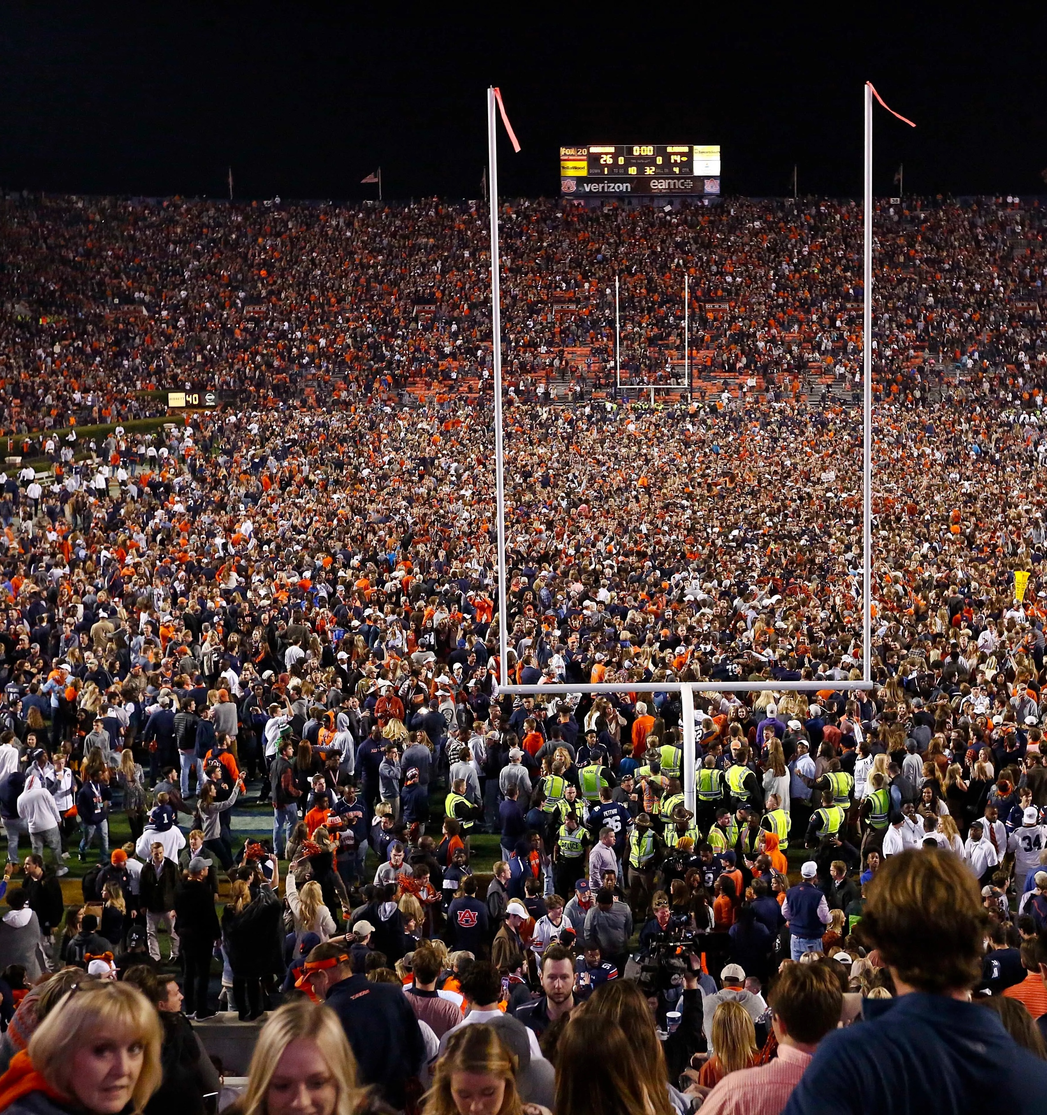

Use Cases
This project was designed with multiple audience versatility in mind and is fit for a wide range of use cases including:
Coaches
Fans
Media Members
Notes:
This slide highlights the various audiences that can benefit from the system. The model can assist coaching staffs with quick opponent evaluations, help analysts generate summaries for broadcasts or written reports, and provide fans with structured insights into team performance. The diversity of use cases shown here demonstrates the flexibility of the system and its potential value across different stakeholder groups.

Slide 10
Experiments Log
Notes:
This slide shows the latency and cost of the model by the numerous tests I ran over the course of this project. As you can see the cost remained at zero for the duration of the project while latency slowly increased. The rise in latency is noticeable and can be attributed to the addition of more context files being added which increase the amount of information the model must interpret before I can produce an output. This rise in latency is not a concern though as it is still well under the original goal of 30 minutes. The two outliers are tests that failed due to reaching the API’s max token limit.

Slide 11
Experiments Log
Notes:
This slide shows the temperature and top p settings I used across all my tests. As you can see these remained relatively stable throughout the project except for a few occasions where they were variable being tested. Top P was initially at 0.4, but after multiple tests (Test IDs 25-30) it was decided to raise the top p setting to 0.7 to allow the model more flexibility. This was done in conjunction with adding the large context blocks and proved necessary for the model to appropriate evaluate the additional context.

Slide 12
Before & After
Early iterations of the project produced inconsistent results.
Missing JSON fields, hallucinations, weak grounding in data
The prompt template was refined to:
Tighten the output schema to force the model to return a JSON file
Provide better context through API calls instead of web scraping
Protect against hallucinations by updating the safety and refusal block
Pass Rate Before Improvement:
40%
Pass Rate Before Improvement:
100%
Notes:
This slide shows how the updated prompt clearly improved the model’s performance. In the early version, the system only passed two out of five tests because it kept missing required fields and wasn’t always grounded in the data. After tightening the instructions and adding clearer structure, the improved version passed all of its tests. This demonstrates that the changes I made directly increased reliability and helped the model stay consistent with what the project required.

Slide 13
Thank You for your Time and Consideration
Notes:
This closing slide summarizes the outcome of the project. The system demonstrates that disciplined prompt engineering, clear evaluation criteria, and ethical safeguards can produce a reliable tool for generating structured scouting reports. The project provides a strong foundation for future enhancements, such as expanding data coverage, improving evaluation methods, or integrating the model into a larger analytics workflow.

